Slide 1
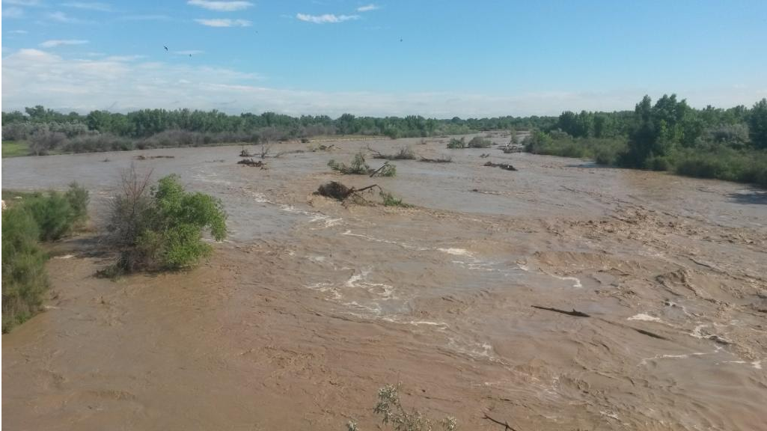
USGS Precipitation and
Streamgage Network
Krystal Brown
August 5, 2020
USGS Colorado Water Science Center

Slide 2
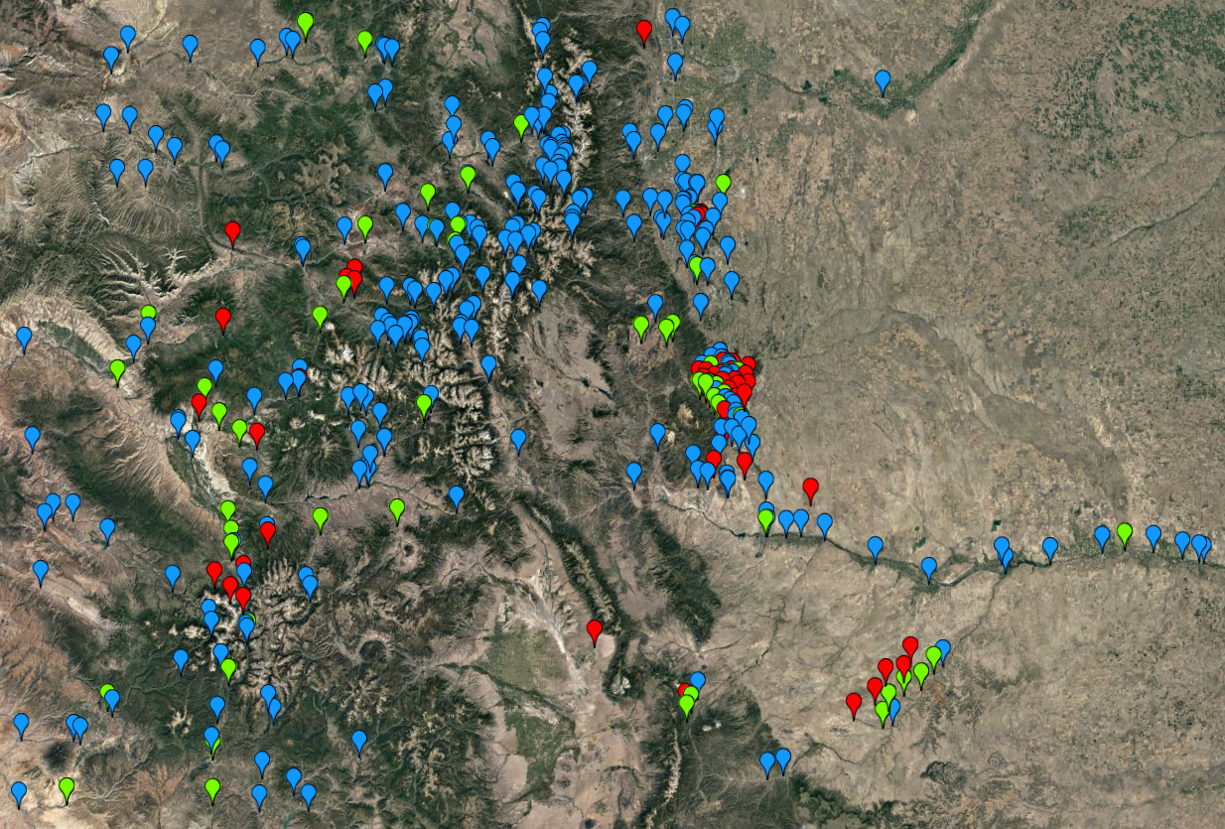
USGS Colorado Real-Time Network
Streamgage Site
Denver
Precipitation Site
Grand
Junction
Colorado
Springs
Streamgage/Precipitation Site
Pueblo

Slide 3
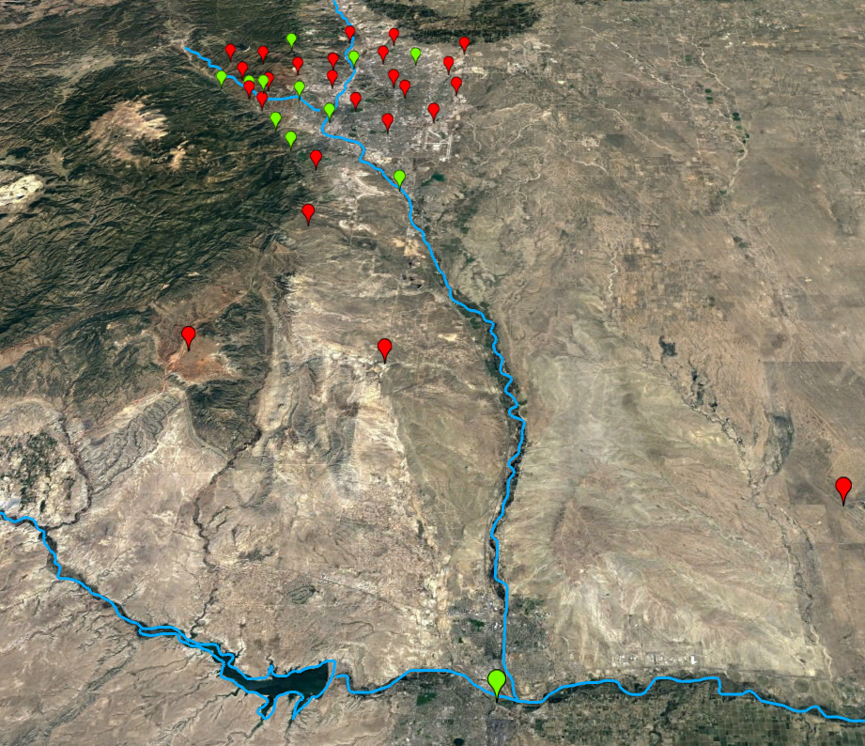
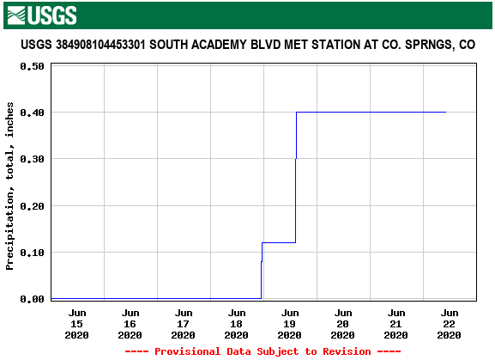
USGS Colorado Real-Time Precipitation Gage Network
Colorado
Springs
Fountain
Precipitation Site
Streamgage/Precipitation Site
Pueblo
Interactive Precipitation Map
https://co.water.usgs.gov/infodata/COPrecip/index.html

Slide 4
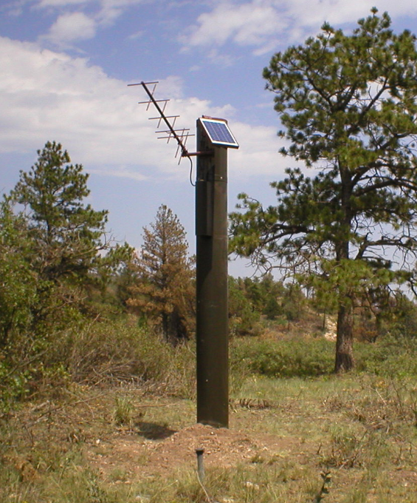
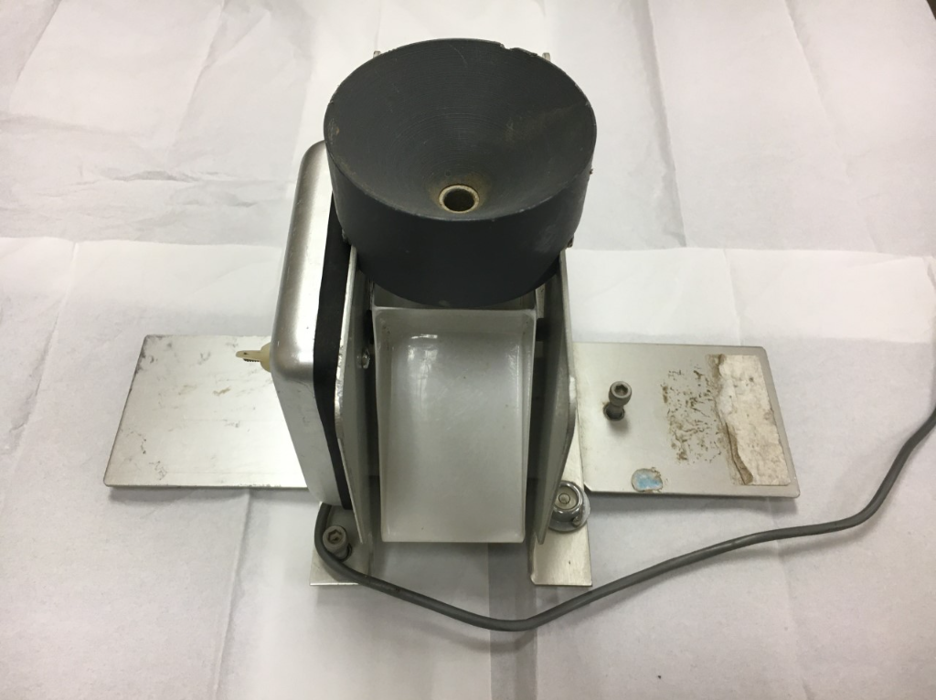
How Precipitation is Monitored

Slide 5
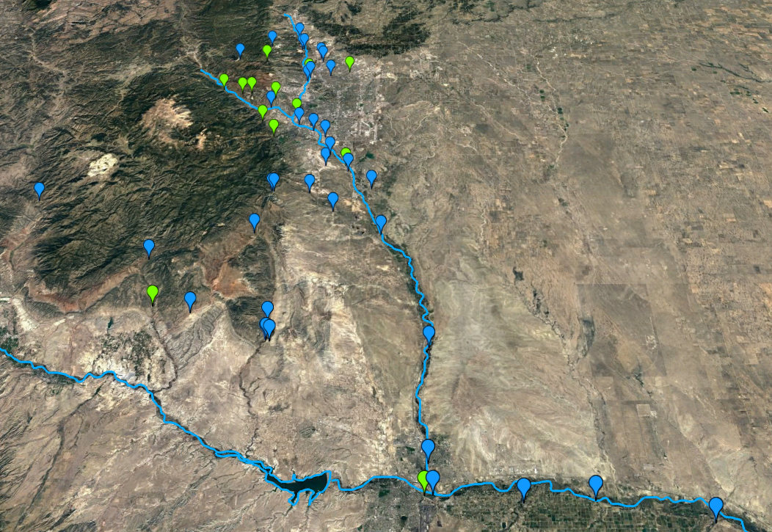
USGS Colorado Real-Time Streamgage Network
Streamgage Site
Colorado
Springs
Streamgage/Precipitation Site
Fountain
Pueblo
USGS Mapper
https://maps.waterdata.usgs.gov/mapper/index.html

Slide 6
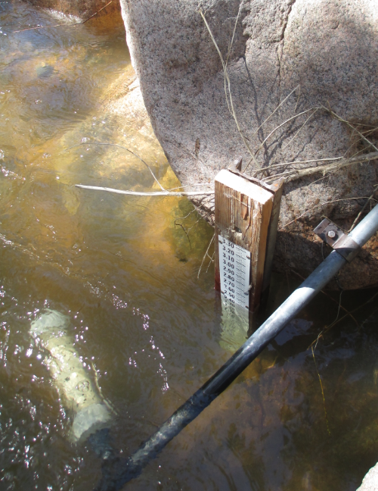
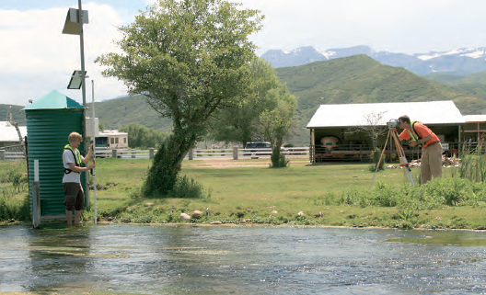
How Streamflow is Monitored
Gage Height or Stage
Measure the height of the water surface above an established altitude
Survey stage reference elevations near a streamgage location

Slide 7
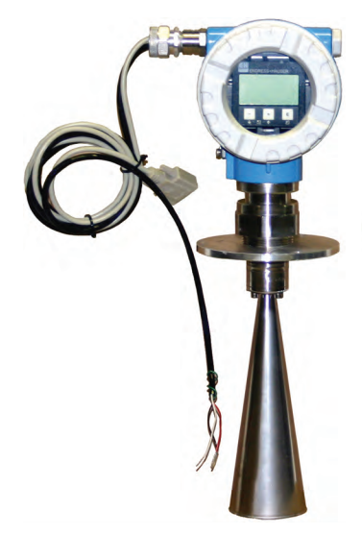
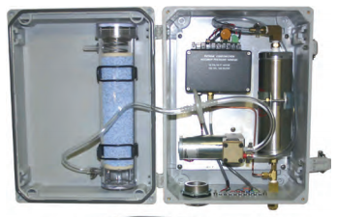
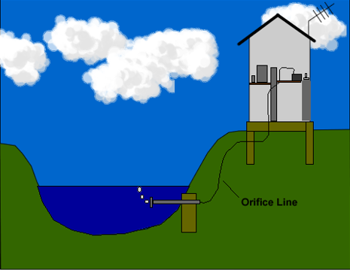
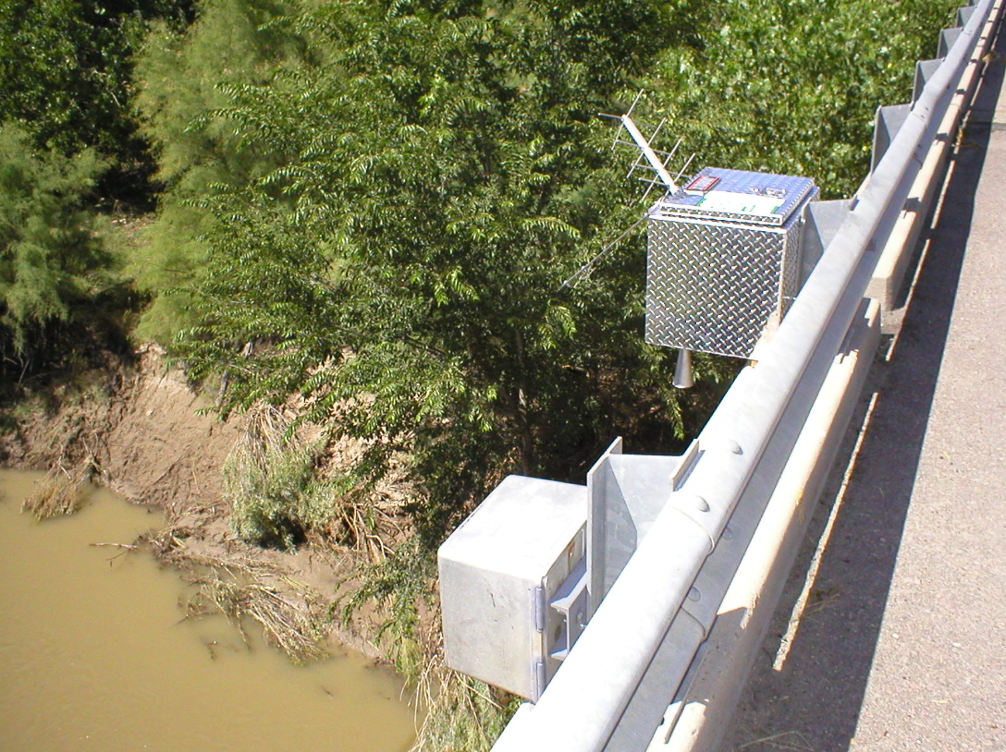
How Streamflow is Monitored
Non-submersible Pressure Transducers
Non-contact Radar Sensors

Slide 8
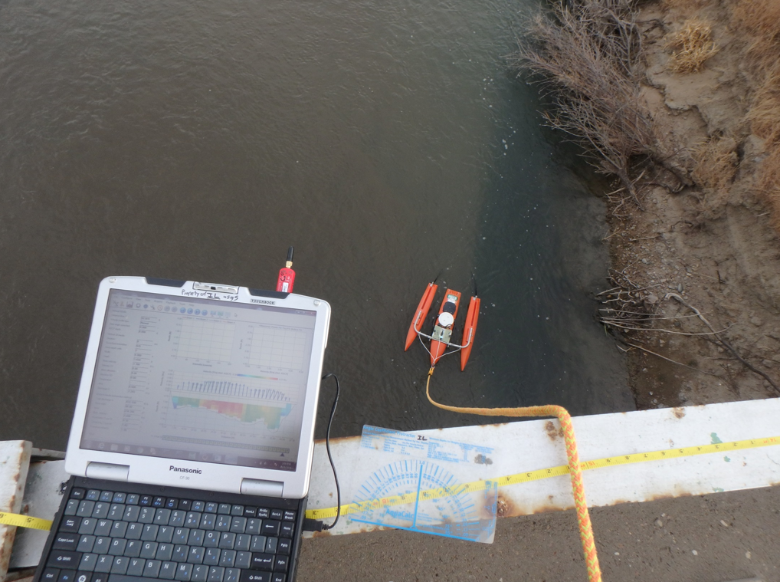
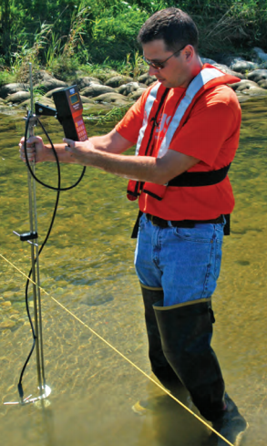
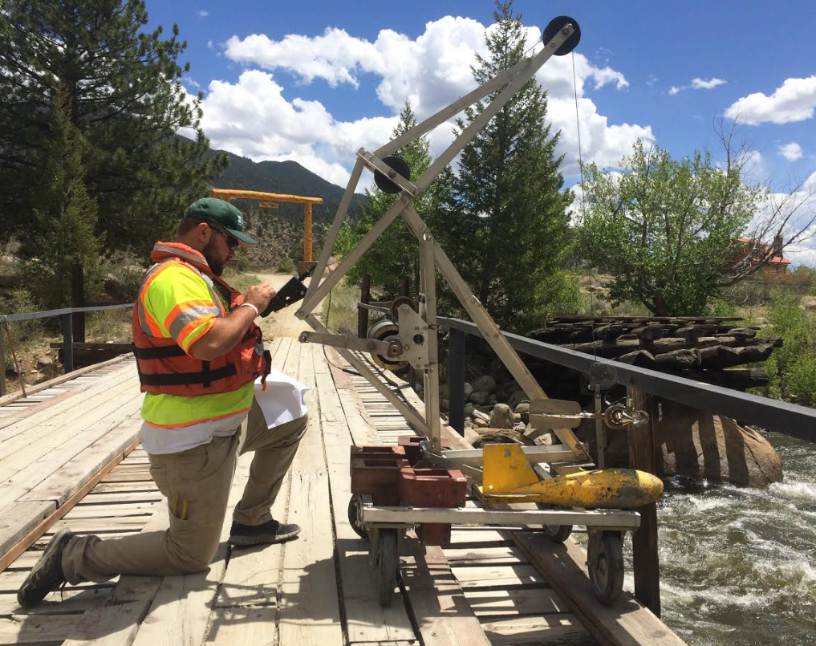
How Streamflow is Monitored
Discharge
=
Velocity x Area

Slide 9
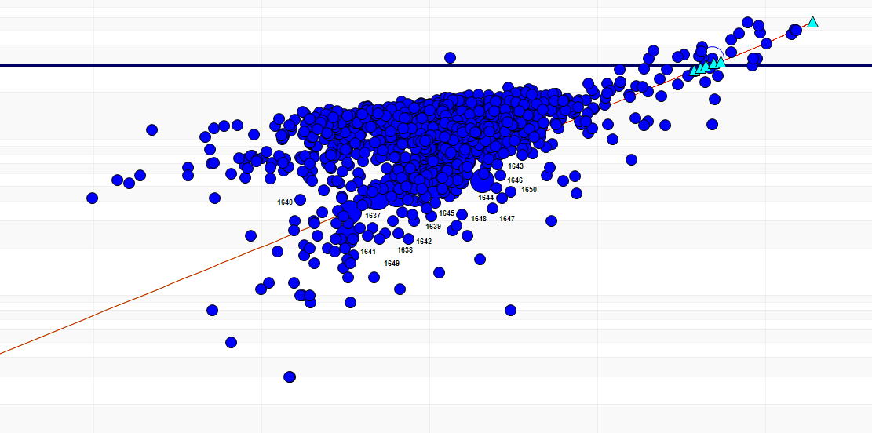
How Streamflow is Monitored
Fountain Creek at Pueblo
13.90
3.90
Gage height (ft)
2.90
1
10
100
1,000
10,000
Discharge (cubic feet per second)

Slide 10
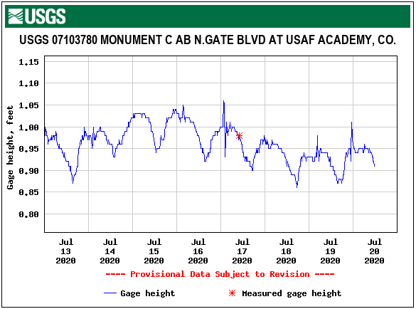
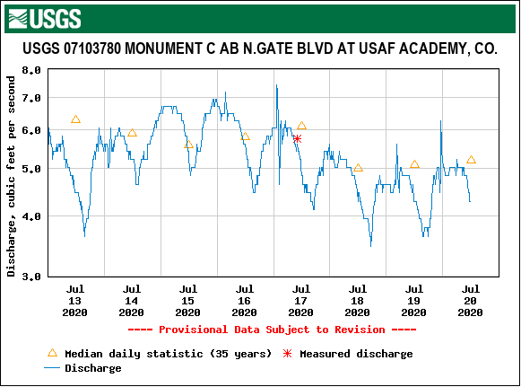
How Streamflow is Monitored

Slide 11
USGS Colorado Real-Time Streamgage Network
Streamgage Site
Colorado
Springs
Streamgage/Precipitation Site
Fountain
Pueblo
USGS Mapper
https://maps.waterdata.usgs.gov/mapper/index.html

Slide 12
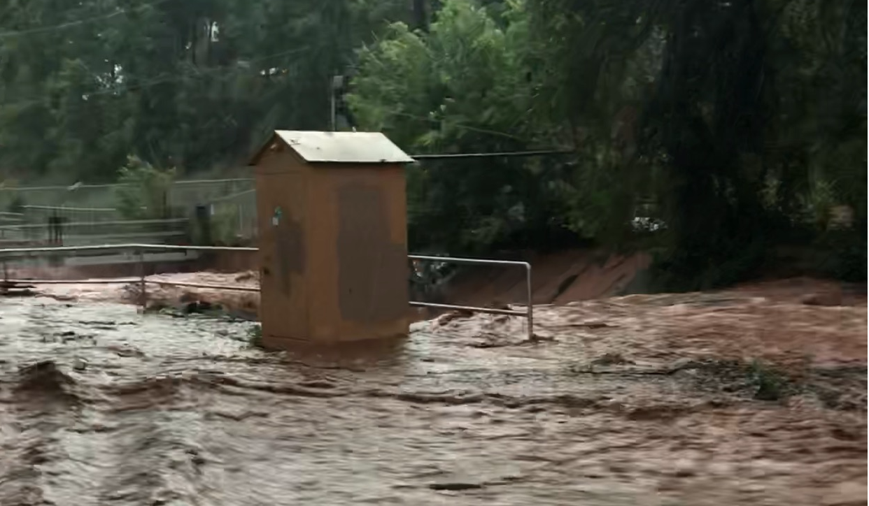
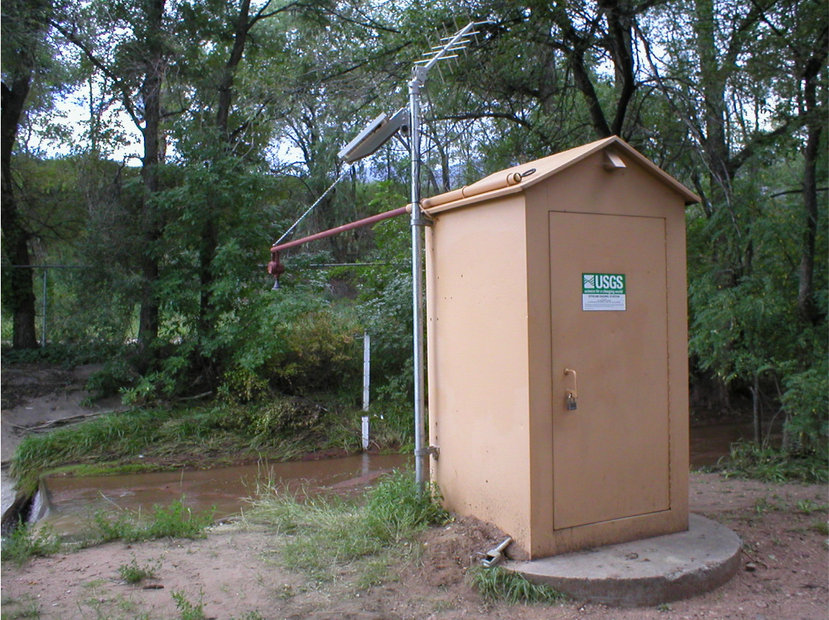
Fountain Creek near Colorado Springs
July 23, 2018
Baseflow

Slide 13
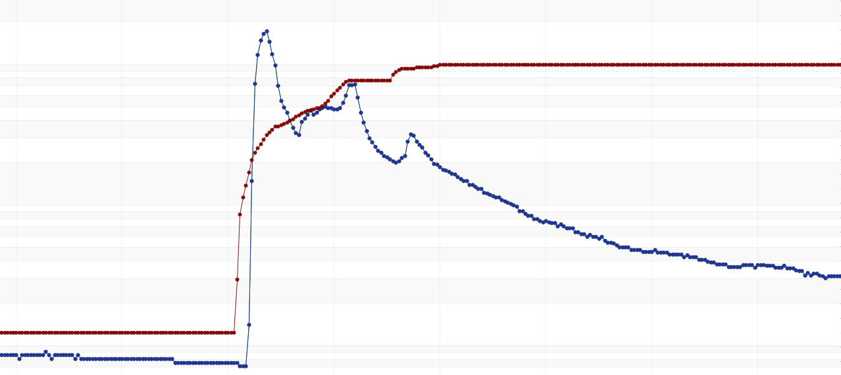
Transit Times
2.0
1,000
1.0
Discharge (cubic feet per second)
100
Precipitation (inches)
0
10
July 23
July 24
Waldo Canyon abv Mouth
Fountain Creek nr CO Springs

Slide 14
USGS Colorado Real-Time Streamgage Network
Streamgage Site
Colorado
Springs
Streamgage/Precipitation Site
Fountain
Pueblo
USGS Mapper
https://maps.waterdata.usgs.gov/mapper/index.html

Slide 15
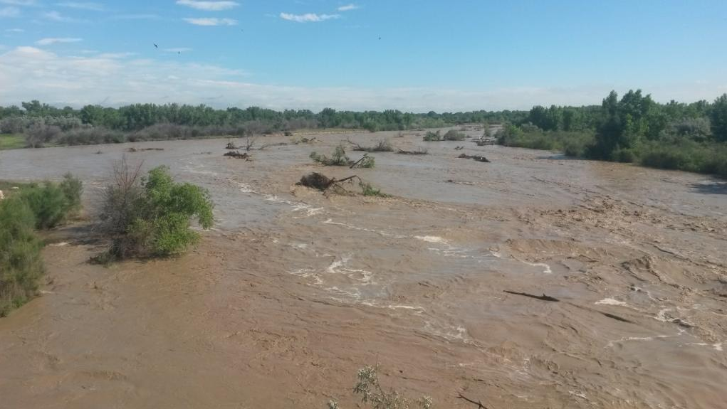
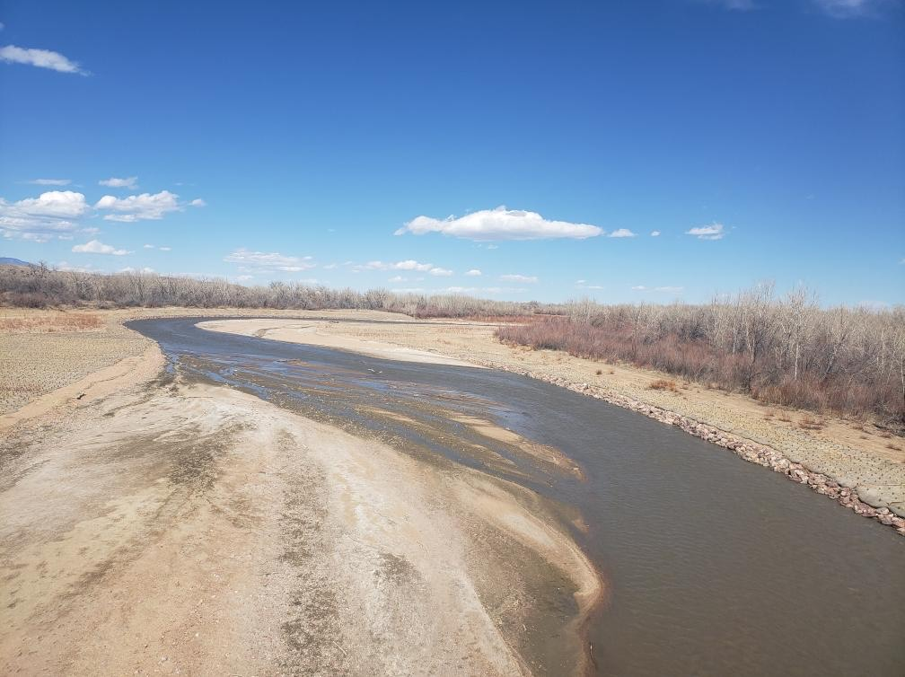
Fountain Creek at Pinon
June 16, 2015
Baseflow

Slide 16
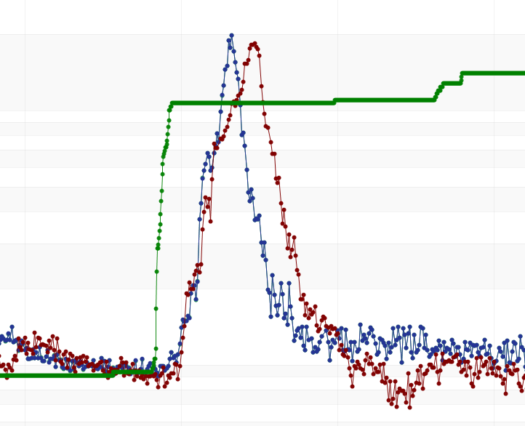
Transit Times
Fountain Creek
At Pinon
Fountain Creek
At Pueblo
Oak Meadow Park Met Station
20,000
3.0
15,000
2.0
Precipitation (inches)
Discharge (cubic feet per second)
10,000
1.0
5,000
0
0
June 15
June 16
June 17
June 18

Slide 17
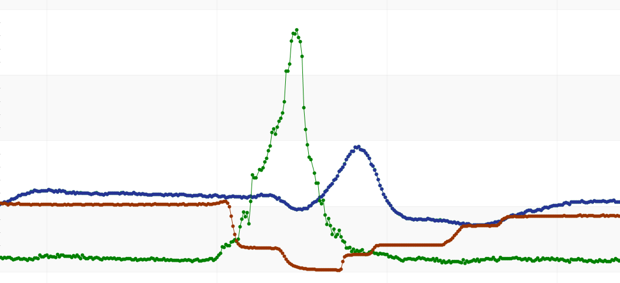
Transit Times
Arkansas River at Moffat St.
Fountain Creek at Pueblo
Arkansas River nr Avondale
20,000
2015
15,000
10,000
Discharge (cubic feet per second)
5,000
0
June 15
June 16
June 17
June 18

Slide 18
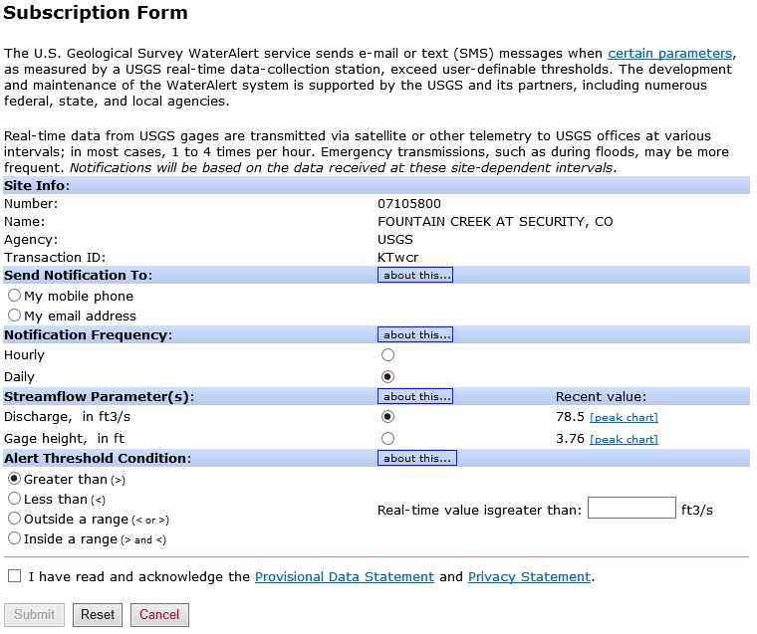
USGS Water Alert
Automatic email or text messages when data exceeds user-defined thresholds
https://maps.waterdata.usgs.gov/mapper/wateralert/

Slide 19
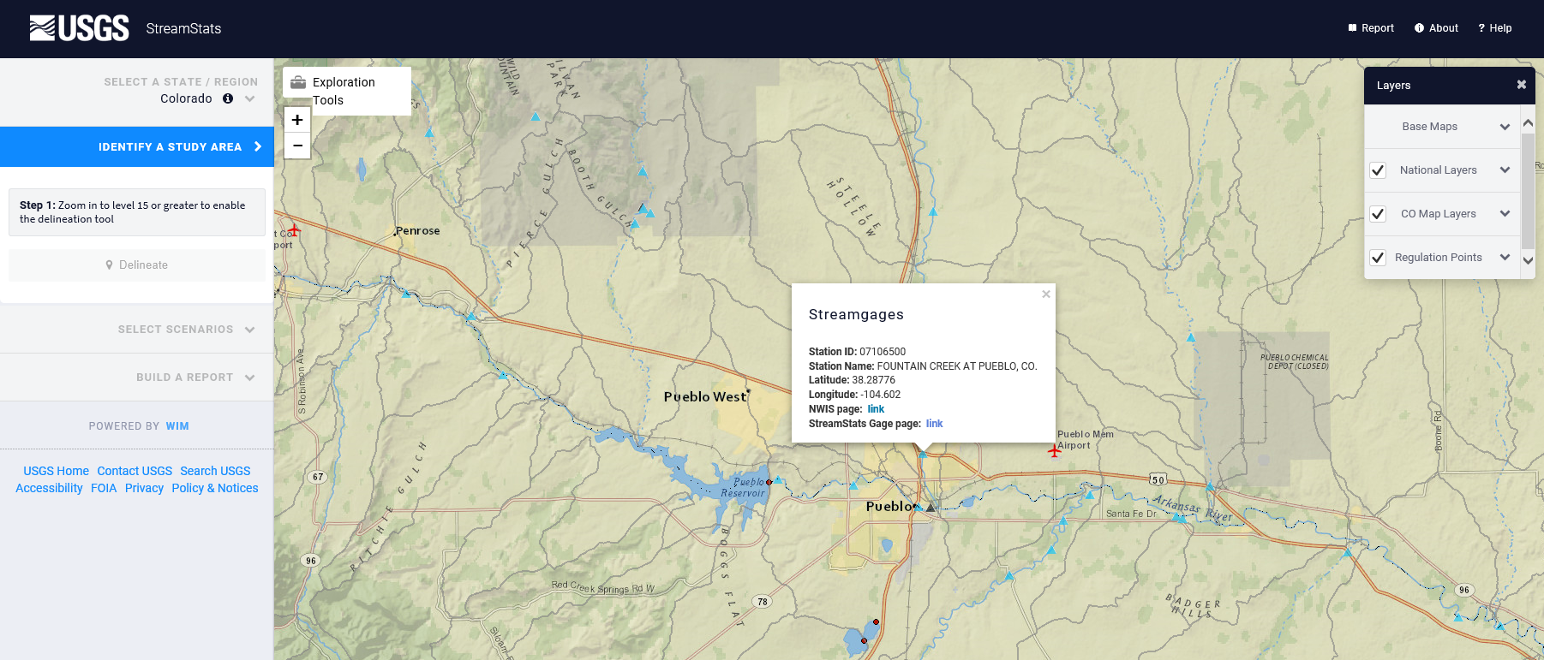
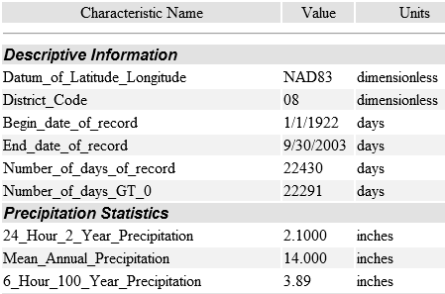
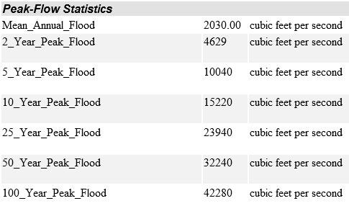
https://streamstats.usgs.gov

Slide 20
USGS Web Based Tools
USGS Data and Tools
https://www.usgs.gov/centers/co-water/data-tools
USGS Mapper
https://maps.waterdata.usgs.gov/mapper/index.html
Interactive Precipitation Map
https://co.water.usgs.gov/infodata/COPrecip/index.html
USGS Water Alert
https://maps.waterdata.usgs.gov/mapper/wateralert/
USGS StreamStats
https://streamstats.usgs.gov

Slide 21
Questions?
Krystal Brown
kbrown@usgs.gov
719-250-0096

